Slide 1

Multi-Dimensional Journey

Slide 2

Grounding Frequency
Explore the limitless possibilities across three floors of frequency-based experiences.

Slide 3
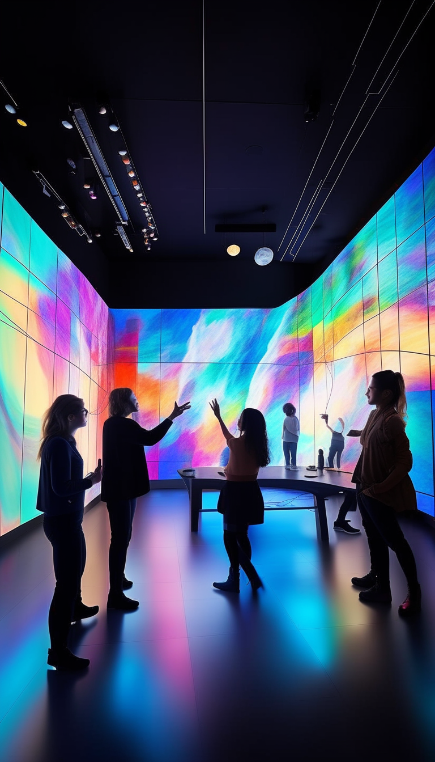
Creative Current
Deep relaxation and inner harmony await on the Grounding Frequency floor.

Slide 4
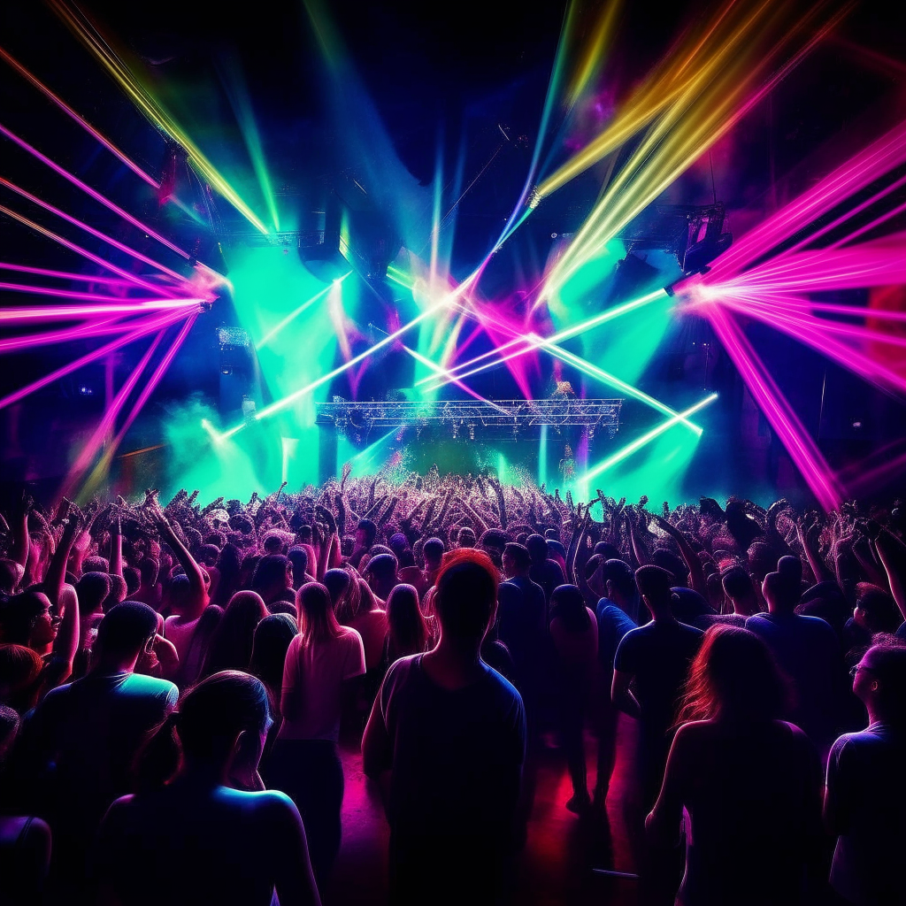
Sonic Surge
Step into the Creative Current and unleash your innovation potential.

Slide 5

Intimate Exploration
Enter a high-energy realm where collective joy and heightened sensations await.

